Slide 1
AWS Demo

Slide 2
Upload Data and store original data
Transform the data to internal format
Visualize and Tag Data

Slide 3
“Semi customers are not yet ready for cloud”
--Soliton & NI
“Semi customers are starting to embrace Cloud ”
--AWS

Slide 4
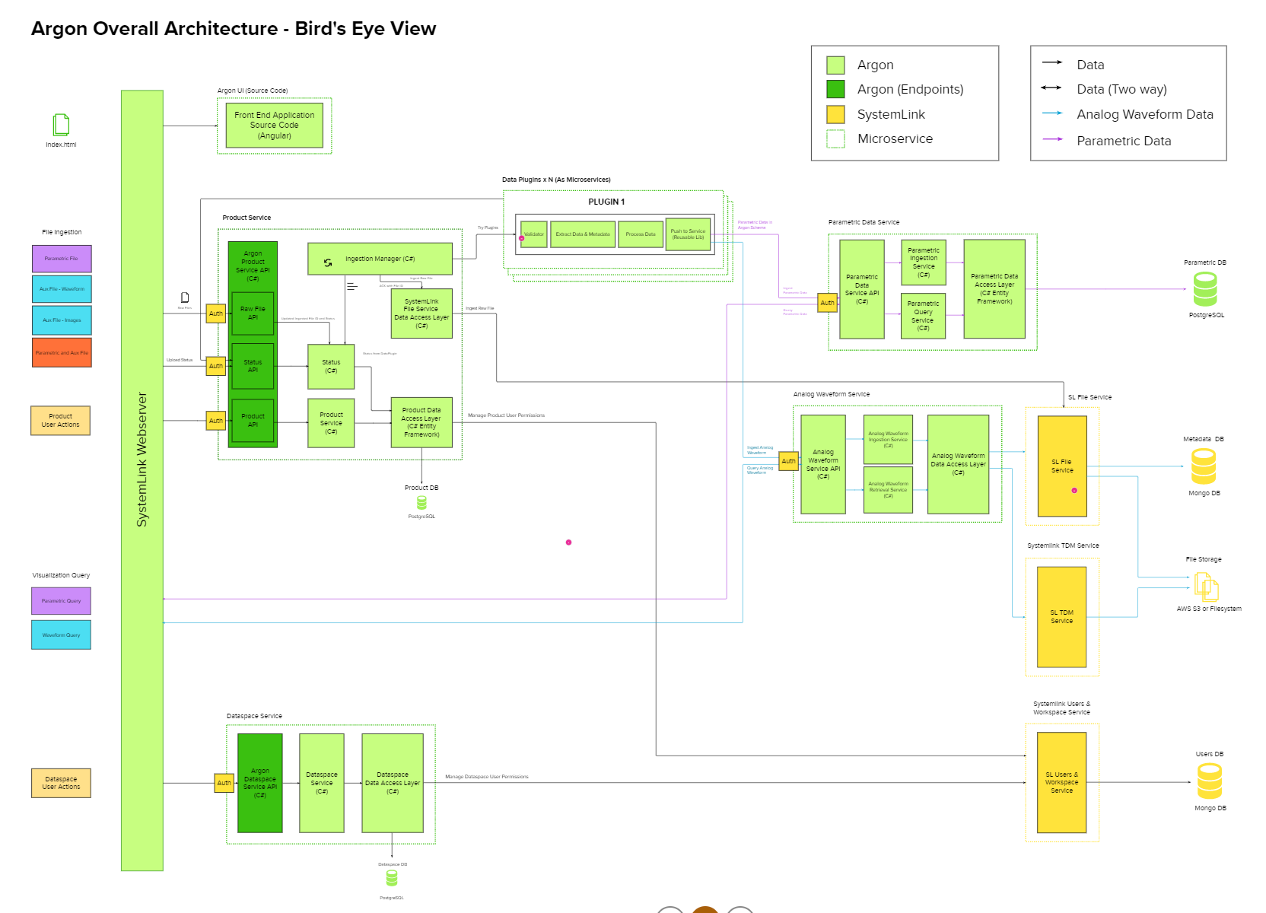

Slide 5

What is AWS
Amazon web service is an online platform that provides scalable and cost-effective cloud computing solutions

Slide 6
AWS Services
Amazon Simple Storage Service (S3)
AWS Lambda
Amazon Athena
Amazon QuickSight

Slide 7

Amazon Simple Storage Service (S3)
Amazon Simple Storage Service (Amazon S3) is an object storage service offering industry-leading scalability, data availability, security, and performance

Slide 8

AWS Lambda
AWS Lambda is a serverless, event-driven compute service that lets you run code for virtually any type of application or backend service without provisioning or managing servers

Slide 9

Amazon Athena
Amazon Athena is an interactive query service that makes it easy to analyze data in Amazon S3 using standard SQL

Slide 10

Amazon QuickSight
Amazon QuickSight is a service that allows us to create data visualizations and dashboards
Amazon QuickSight allows you to connect your data from many different data sources.

Slide 11
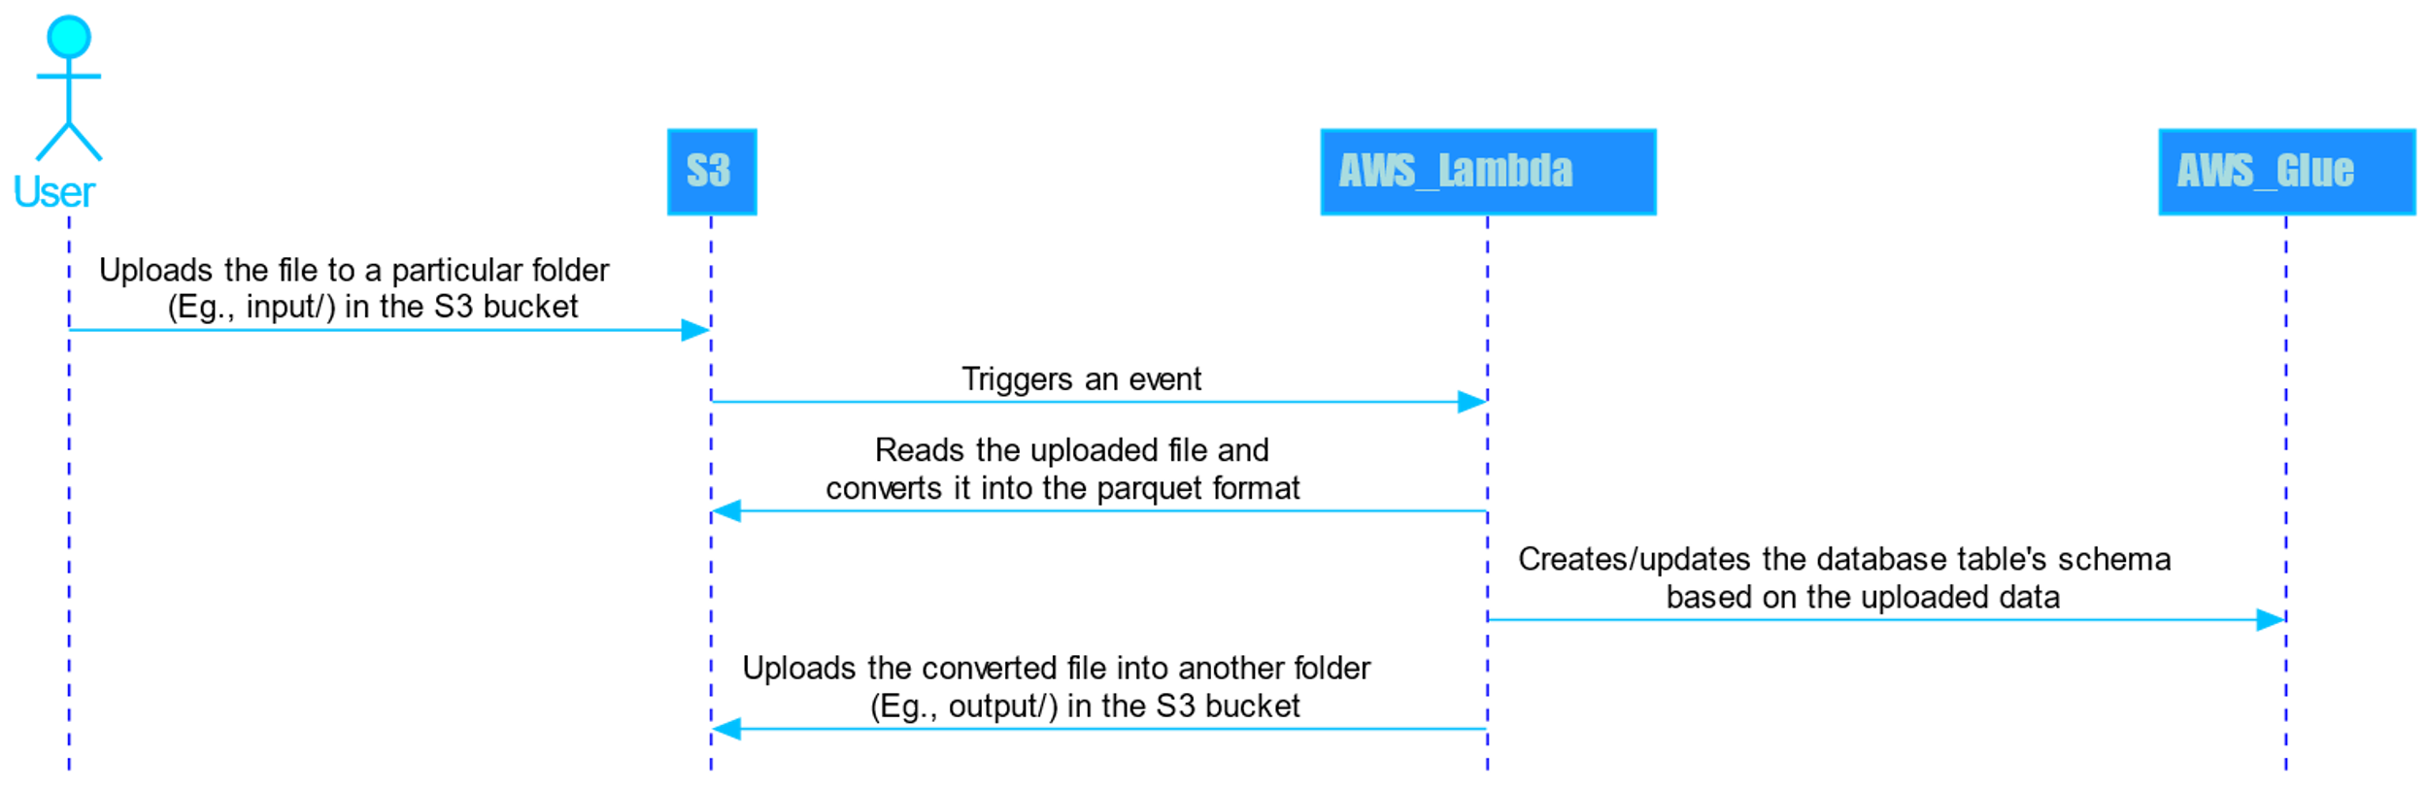
User Flow to upload the file

Slide 12
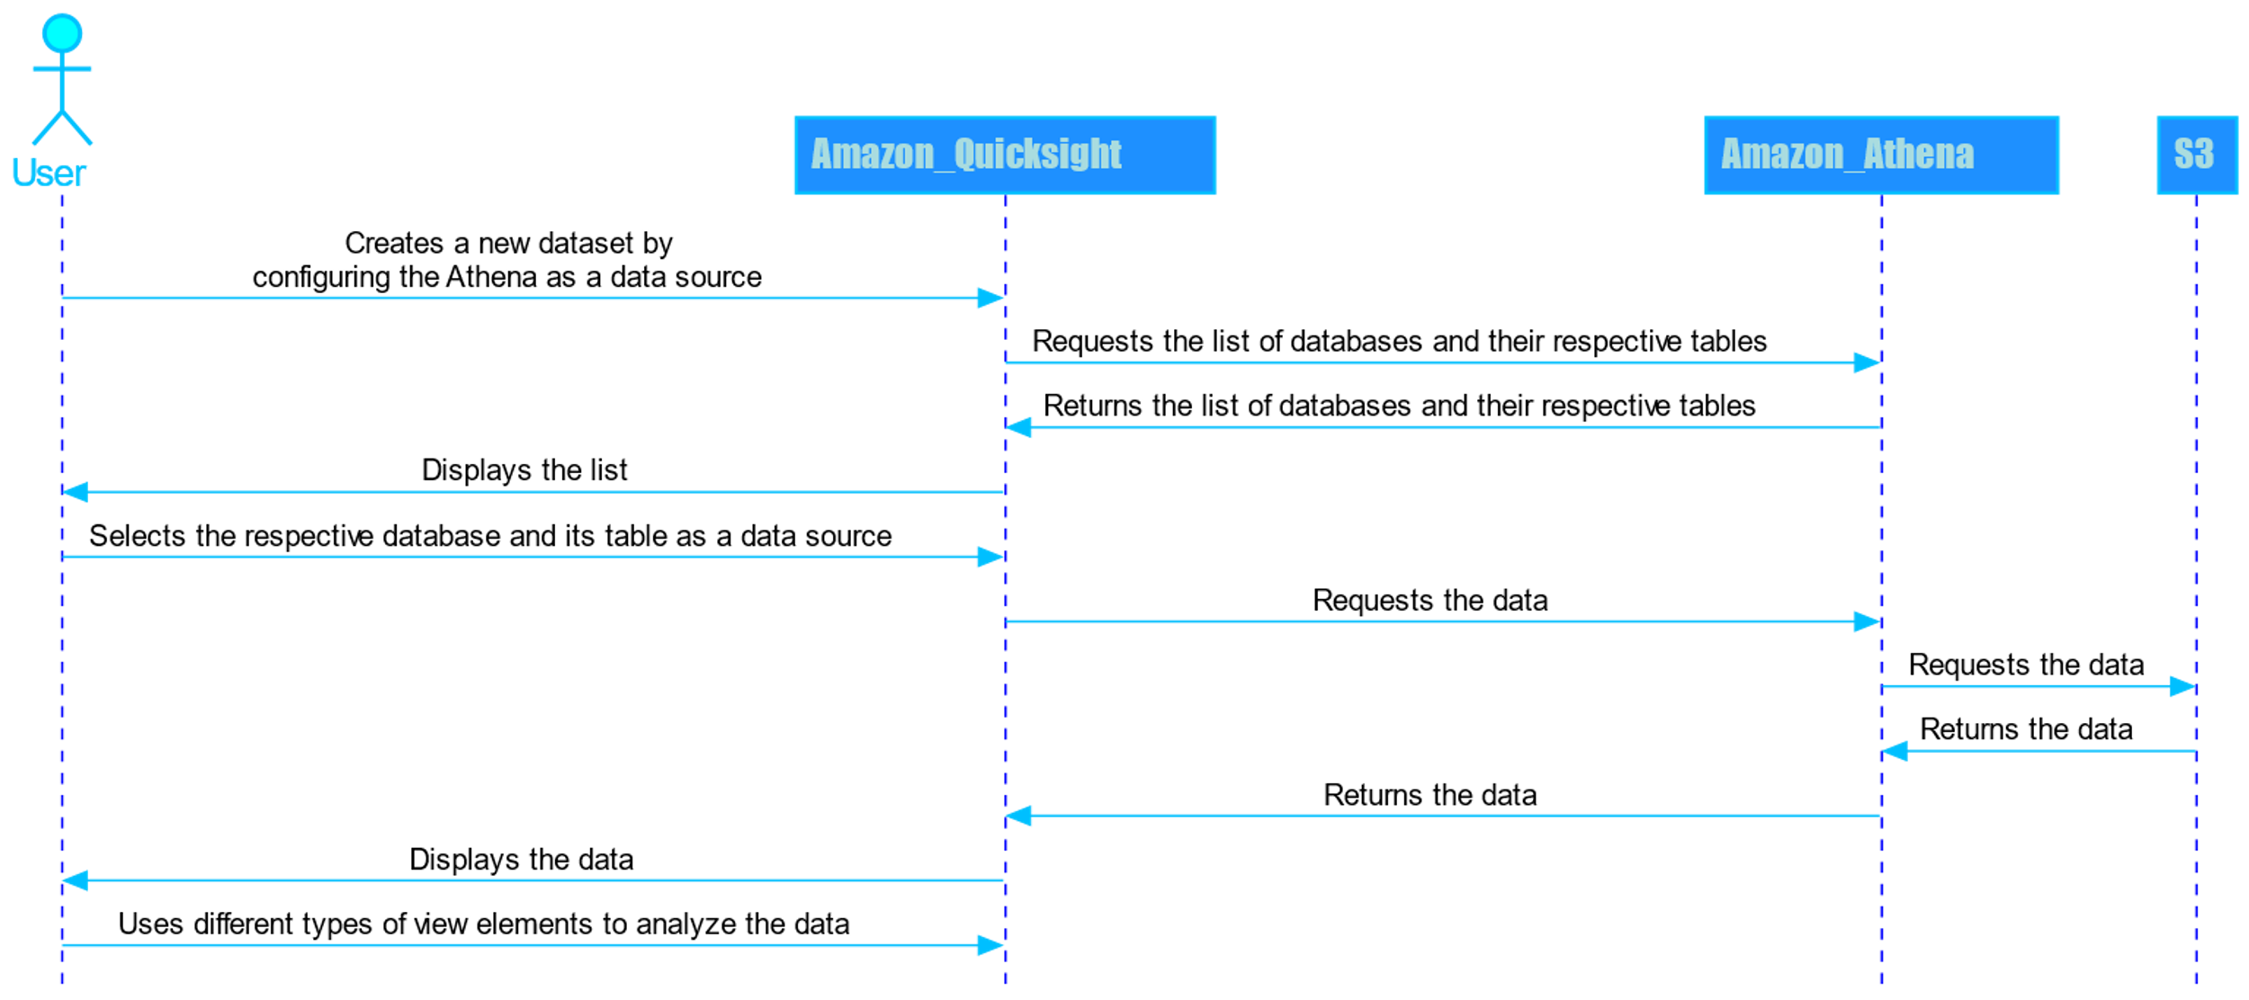
User Flow to view the uploaded data

